Slide 1








SAVAGES ONLY
MID-TERM
PROJECT

Slide 2
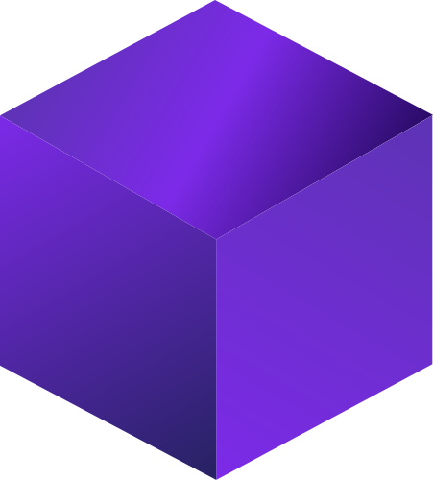



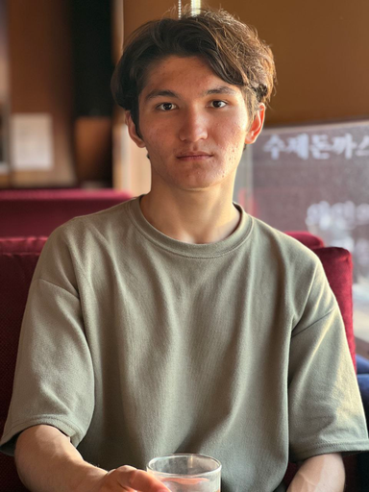
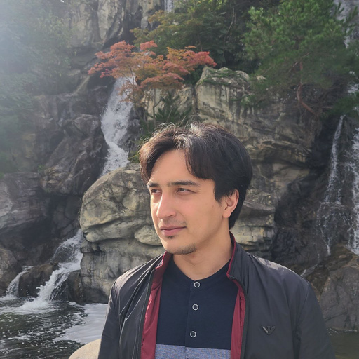

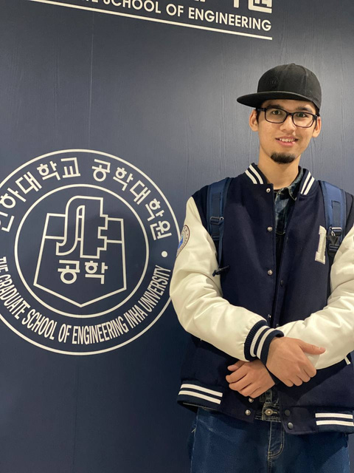
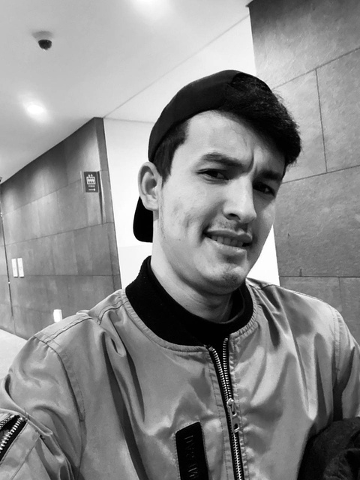
Temur
12200338
SAVAGES
Khumoyun 12194949
sAVAGES
Ali 12200312
Adham 12200317

Slide 3


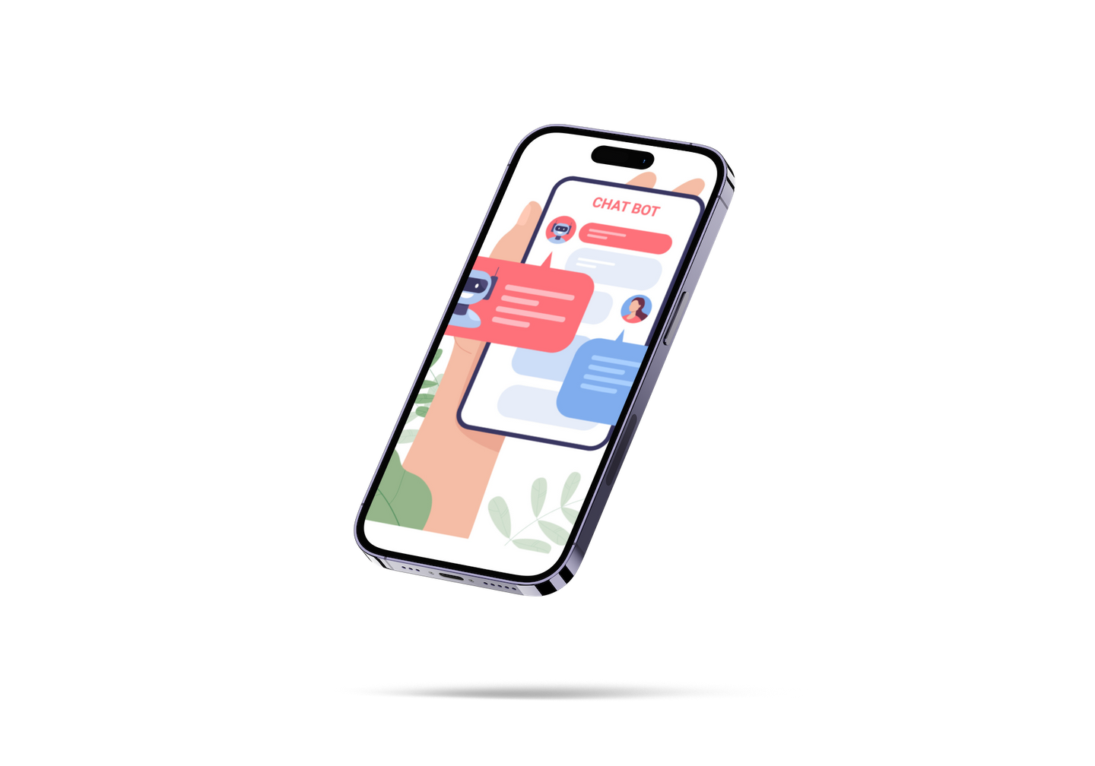
03
Introduction
Introduction
We are excited to introduce our new project, which combines the power of MapQuest and GPT-3 APIs to create a unique and innovative user experience. Our project aims to provide users with a personalized and context-aware voice-based navigation system by using MapQuest API to get matrix routing of given locations and GPT-3 API to generate brief instructions based on the outputs of MapQuest API's response.

Slide 4





The Reasons
We chose this project because it combines the power of two APIs, GPT-3 and MapQuest, to create a unique and innovative user experience. By integrating GPT-3's language generation capabilities with MapQuest's mapping and location services, we can create a seamless and personalized experience for users.

Slide 5







GitHub Collaboration
GitHub Collobaration
Repo & Branches
We have created 1 repository and every team member created their own branch by pulling main brarnch
Commits
After completing one's task, each member committed changes with specific message about what they have done
Merging commits & Code Review
After completing each task, team members opened new pull request, and asked for review from other team members. At the end merged ready code to the main branch

Slide 6


Project Management
Creating Backlogs
Before starting project team members had a meeting and discussed what are the tasks to do to finish the project
Progress
After creating backlogs team leader assigned tasks to each team member based on their skillset
End of Sprint
Project ended with each team members completing assigned tasks. Team leader and recorder checked team members tasks using Trello

Slide 7
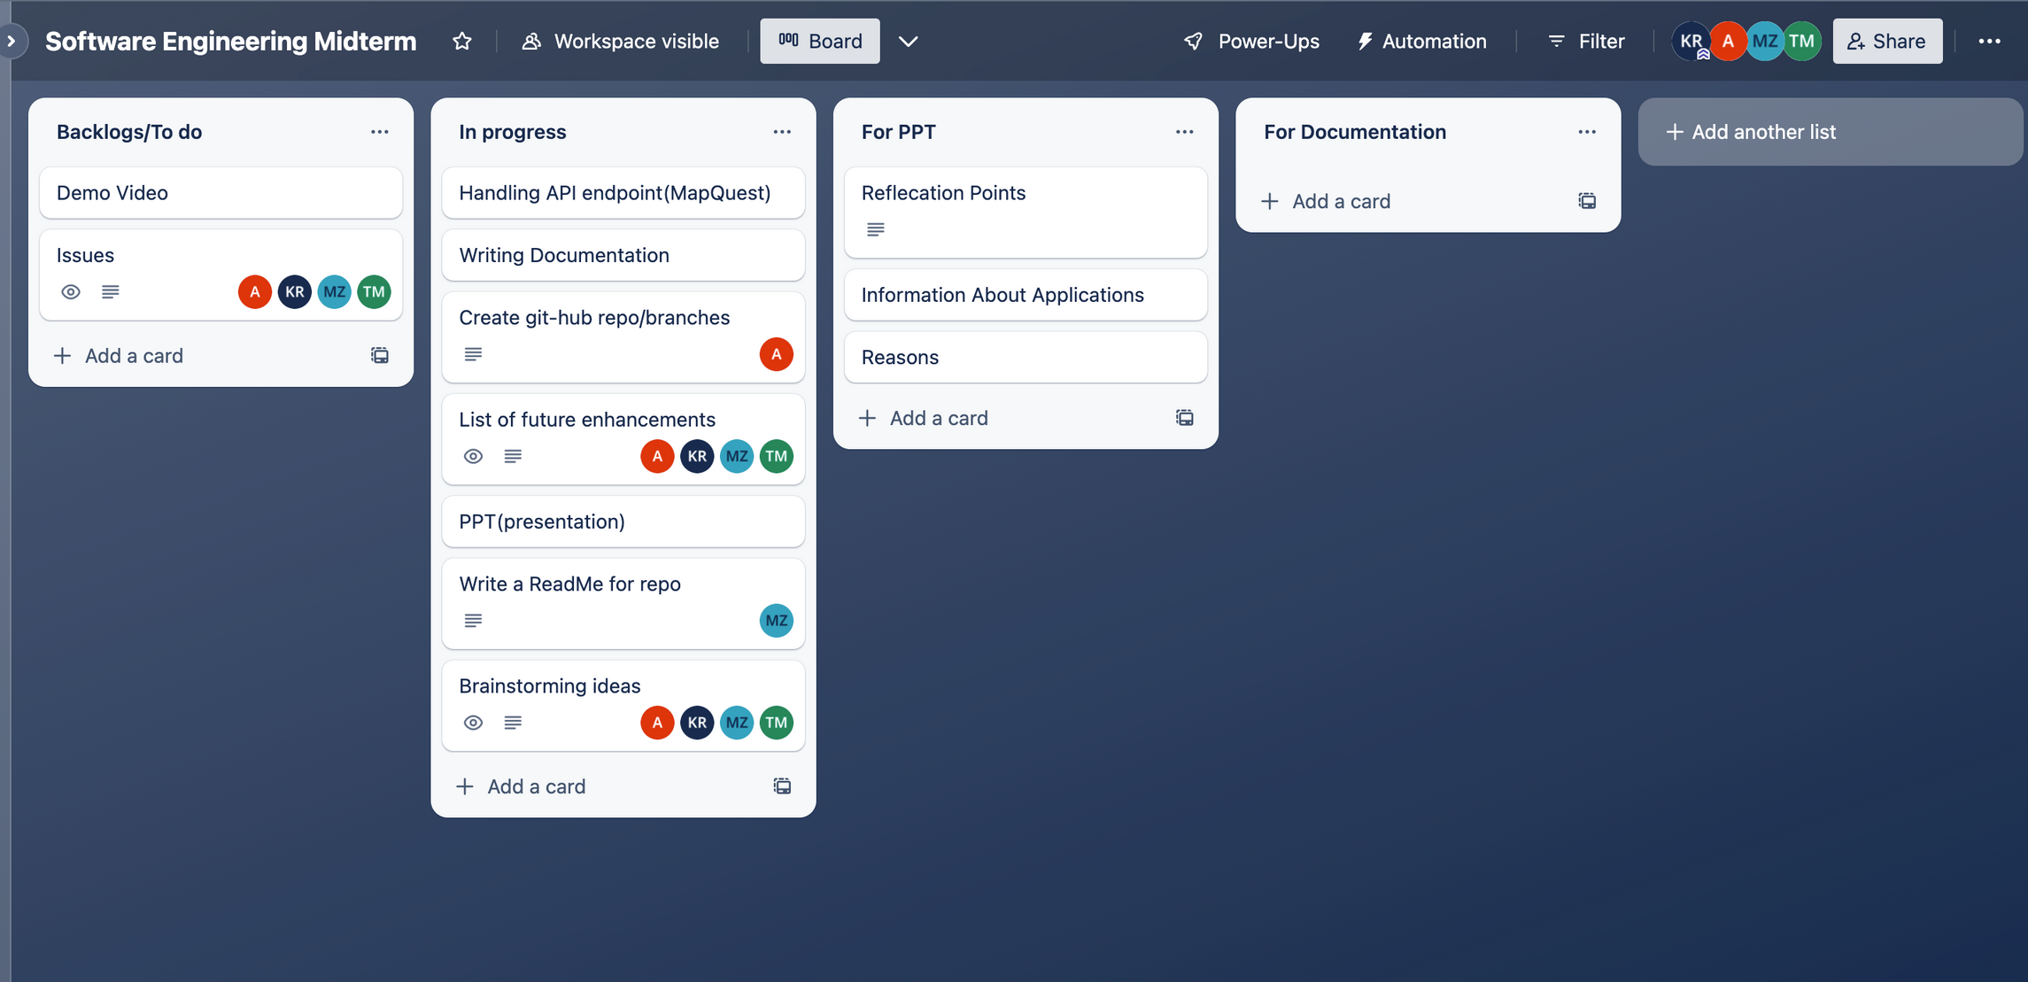
Project Management

Slide 8

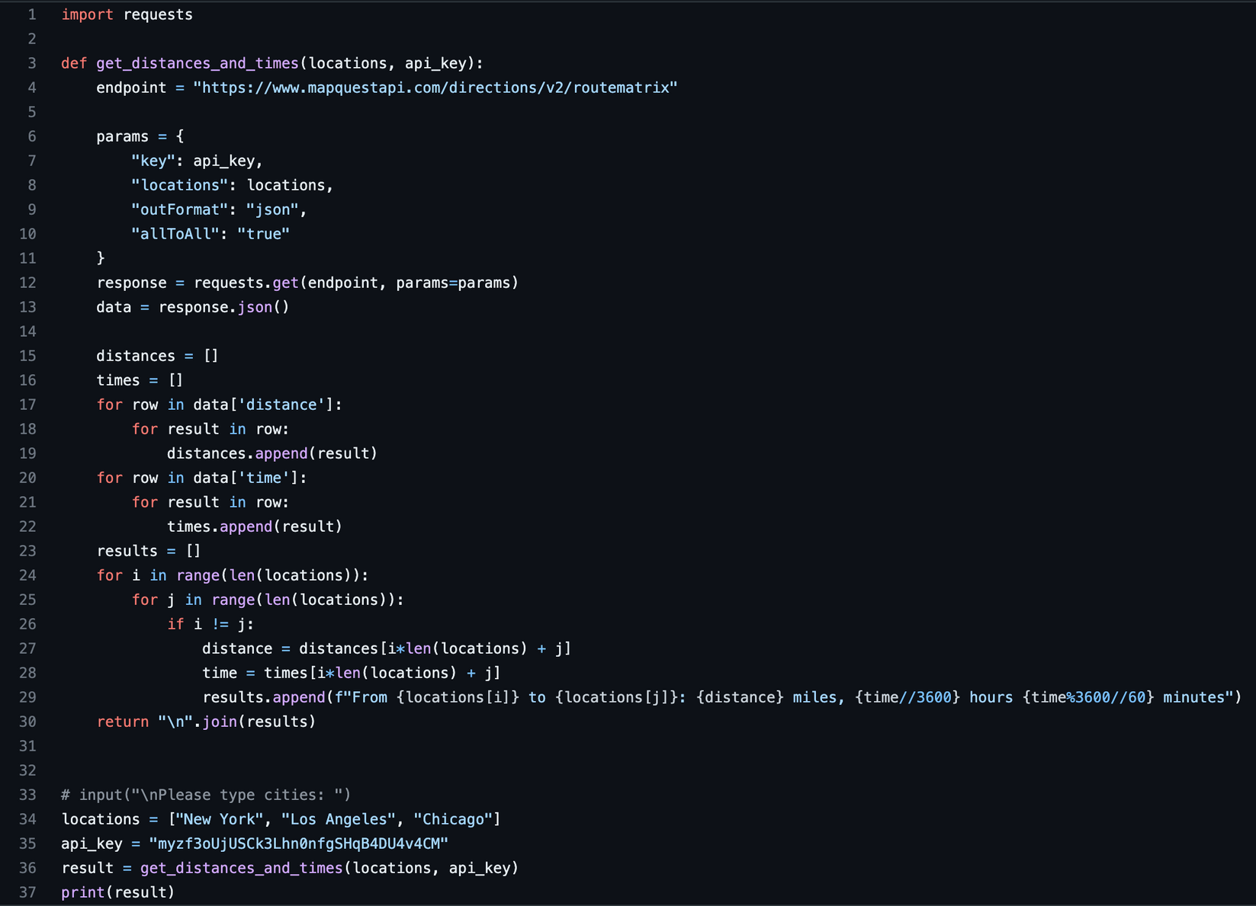
MapQuest API integration
This code defines a function `get_distances_and_times` that takes in two arguments: a list of locations and an API key for the MapQuest API. The function sends a GET request to the MapQuest API's RouteMatrix endpoint to obtain the distances and times between all pairs of locations. It then extracts the distances and times from the response and formats them into a string of results. Finally, it returns this string of results as the output of the function.
The code then creates a list of locations and an API key, calls the `get_distances_and_times` function with these arguments, and prints the resulting string of results to the console.
SAVAGES
sAVAGES

Slide 9
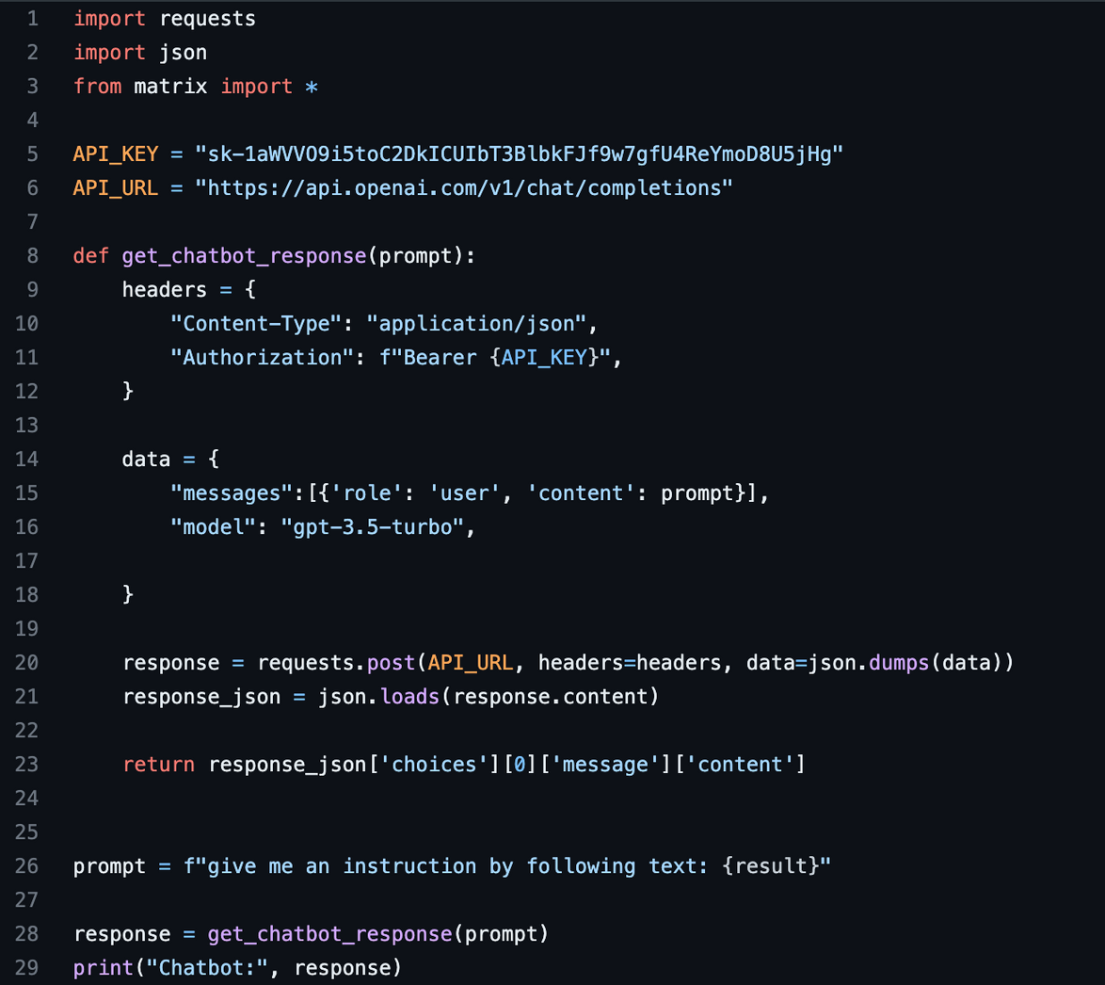
GPT API integration
SAVAGES
sAVAGES

Slide 10
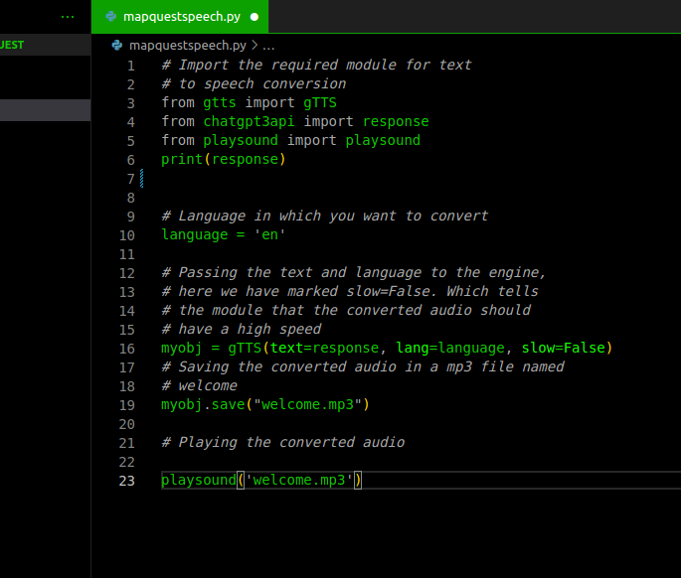
SPEECH Module:
After all the processes this will be the last module where we can hear all what it is written on terminal.
SAVAGES
sAVAGES

Slide 11

List of future enhancements
System Voice Assistant
UI
Optimized Routing
Labelled Routes

Slide 12
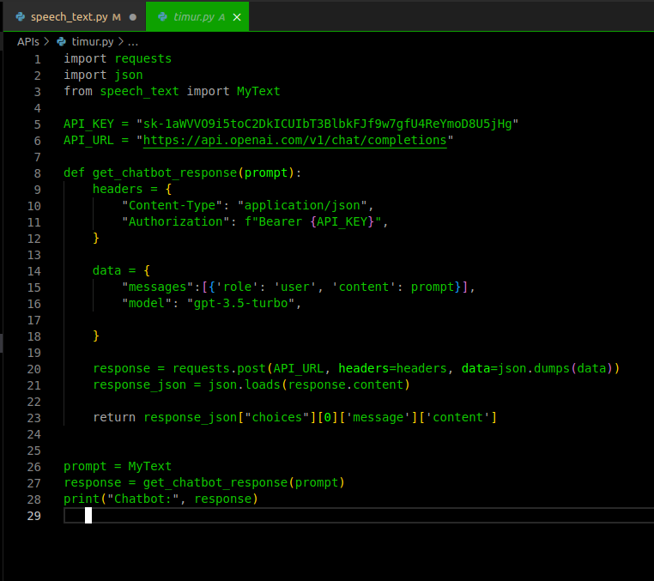
About First Module:
This is a main module, where we implemented chatgpt API request. As an extension this module imports converted speech from {speech_text.py} which is a string in our case, then inputs to ChatGpt API request module (called {timur.py} in our case}. After ChatGpt responses, we will able to see on our terminal its output. (ChatGpt explanation was given in previous slides).

Slide 13
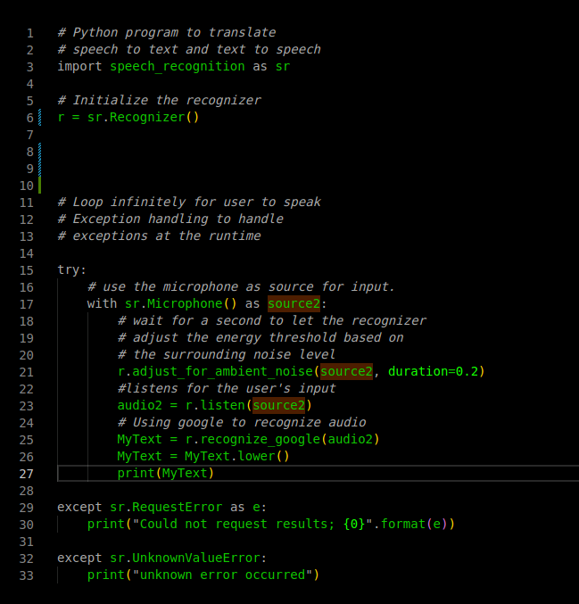
About Second Module:
This module extends aforementioned Open-AI ChatGPT bot's abilities by adding new Voice Input features. This module basically transfers along input to digital. Which in this case converts into characters data or simply saying into strings in python programming language. In-order to release this particular functionality we used speech recognition module.
CODE IS SELF-EXPLANATORY

Slide 14
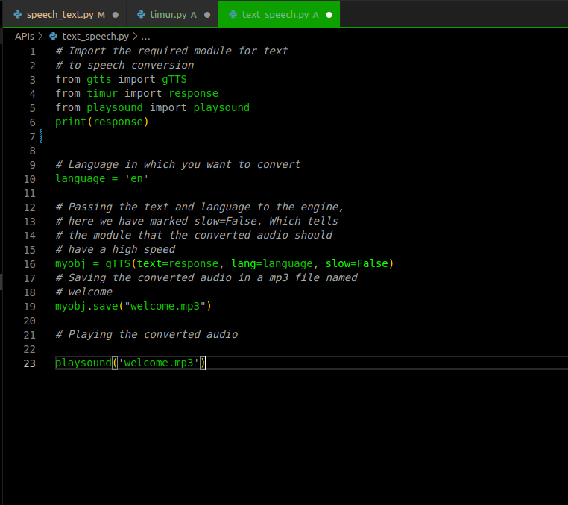
About Third module:
In the final stage we can get that ChatGPT's text output and convert it to mp3 file then play.

Slide 15
Reflection Points:
1. Project Management and Task Distribution: We faced challenges in keeping track of who was responsible for what task and struggled with communication among team members. Agile method with Trello helped us to address these challenges by providing a framework for task management and facilitating communication. We learned the importance of clear communication and task assignment in project management.
2. MapQuest API and GPT-3 API: The benefits of using these APIs were improved routing accuracy and natural language processing capabilities. We faced challenges in integrating them into our project, such as limited API calls and complex API documentation. We found solutions by reaching out to the API support team and experimenting with different API settings. We learned about the importance of thorough API research and testing.
3. Matrix Routing Experience: The goal was to create a more efficient and accurate routing experience between cities. We measured success through user feedback and metrics such as route optimization and distance calculations.

Slide 16
4. Collaboration and Communication: We collaborated through regular team meetings, shared project documents, and frequent communication via messaging apps. We faced issues with time management and conflicting schedules but addressed them by setting clear expectations and timelines. We learned the importance of effective communication and teamwork in project success.
5. Technical Skills: We gained technical skills in API integration, natural language processing, and routing optimization. We encountered technical challenges such as API call limits and software bugs, which we solved by troubleshooting and experimenting with different solutions. We learned the importance of flexibility and problem-solving in technical projects.

Slide 17
Contribution of team members:
1) Vakhitov Akbarali - 12200312 - Built GPT-3 chatbot via api request, a skeleton for the entire project
2) Khumoyun Rakhmonberdiev - 12194949 - Built MapQuest API, provided key aspects of the project development
3) Timur Abdurakhmonov - 12200338 - Built Voice Over Feature (Voice Input and Voice Output). Added an extended feature to make the project distinguished from other projects.
4) Atkham Eshonkulov - 12200317- Documentation, Readme, Video Capturing.

